Slide 1
CANADIAN NATIONAL MASTER
CKC JUNIOR HUNT TESTS
2018
(Short Version)
Notes:
Sources For Good Information on Judging, Field Work and Setting up Good Tests
(Copy links into your browser)
Retriever Field Trial Judging – A Manual - “The Blue Book” Aimed at field trial judges but carries a large amount of information that would translate well to hunt tests and WC/I/X work
https://www.theretrievernews.com/store/p7/Judge%27s_Manual_%28Digital_eBook_Edition%29.html
Retrievers ONLINE - Dennis Voigt has published many outstanding articles on judging in his Retrievers ONLINE magazine and currently appear on his blog.
http://www.retrieversonline.com/
Retriever Field Trial Judging Fundamental and Checklist
http://cdn.agilitycms.com/retrievers-online/AMJ_2012_Judging%20Checklist-hi%20res.pdf
Retriever News
https://www.theretrievernews.com/
CKC Rules and Regulations
https://www.ckc.ca/en/Files/Forms/Shows-Trials/Event-Rules-Regulations/Hunt-Test-Rules-and-Regulations-for-Retrievers-Bar
It is easy to set up tests that eliminate dogs - all dogs can be tricked – but that is not the role of a judge. Judges should be on the dog’s side when judging – not to give it an easy pass – but to bring out the best that dog has to offer on that day.

Slide 2
Table of Contents
TOPIC | SLIDE
Purpose of CKC Hunt Tests | 3
Key Hunt Test Definitions | 4 - 6
Junior Test Requirements | 7
Junior Test Design Considerations | 8 - 9
Evaluating the Junior Dog General Recasts in Junior Handling on Marks in Junior Steadiness in Junior Encouragement of the Junior Dog Hard Mouth Sample Junior Score Sheet | 10 - 20

Slide 3
Purpose of CKC Hunt Tests
The purpose of the hunt test for Retrievers, Barbet, Irish Water Spaniels and Standard Poodles is to test the merits of, and evaluate the abilities of these dogs in the field in order to determine their suitability and ability as hunting companions
Hunt tests should, therefore, simulate as nearly as possible the conditions met in a true hunting situation
- Section 13.1.1 of CKC Rules and Regulations
The purpose of the Junior Hunt Test is (also) to encourage people to continue in the hunt test program
- Section 11.2.1 (a) of CKC Rules and Regulations

Slide 4
Key Hunt Test Definitions
Break
Dog leaves to retrieve without release by handler and is not brought under control
Controlled Break
Dog leaves to retrieve without release by handler but is quickly brought under control verbally or by whistle and returns
In Master, a controlled break calls for a “0” score except in the Upland series where it is considered a minor fault when the dog is brought under immediate control
Creeping
Leaving the handler on a tentative yet excited basis, short of leaving completely
General unsteadiness
Can be a safety issue
Notes:
Break
A break occurs when a dog makes a movement which, in the opinion of the judges, indicates a deliberate intent to retrieve without having been ordered to do so, and cannot be brought under control by the handler
Controlled break
Controlled break is when a dog leaves before being sent but is quickly brought under control by verbal command or whistle and returns to the handler
Discussion should take place at this time on controlled breaks. Controlled break can also occur when the dog stops on its own without handler communicating verbally. If the dog is watching the marks, leaves the handler’s side stops a few feet or more without handler saying sit of whistling, this is a controlled break. Controlled breaks are only while marks are going down or in Master on the sit to flush.
Creeping
Creeping is considered as leaving the handler on a tentative yet excited basis, short of leaving completely to retrieve the bird, or waiting to be sent to retrieve. General unsteadiness short of breaking:
Creeping can be a safety issue in a real hunting situation.
As a guide in their instructions to participants, judges may wish to use a hypothetical creep line of “no creeping beyond the end of the gun barrel”.

Slide 5
Key Hunt Test Definitions Cont’d
Pop
A pop, or popping, is voluntary stopping (without command) and looking back to the handler for direction after having been sent
Diversion Bird
A bird that is thrown and acts to divert the dog from their task at hand as it occurs
Occurs while the dog is actively working in the field as opposed to being at the line
Poison Bird
A poison bird is a mark, seen from the line, that is left in the field while the dog picks up a blind
If the judge chooses to have the poison bird picked up after delivery of the blind, it will be judged as a mark
Notes:
Popping
Popping is characterized as a voluntary stopping (without command) and looking back to the handler for direction.
Discussion could take place at this point with regards to whether a pop also constitutes a dog running/moving forward but glances back.

Slide 6
Key Hunt Test Definitions Cont’d
Recast
Distance should be agreed upon by judges but is usually limited to 15 feet or 4.5 meters
Usually attributed to a dog’s confusion as to whether it was sent
It is not considered a recast when a dog goes to the area of the fall, fails to find the bird and returns (or is recalled)
This must be evaluated as a lack of perseverance
Refusal
Refusal is a disregard of a command
Failure to stop and look at the handler when signalled or failure to continue in new direction for a considerable distance both constitute a refusal
Not coming when called is as bad as not going when sent
Notes:
Recast
Distance should be agreed upon by judges but is usually limited to 15 feet or 4.5 meters……
Discussion could take place with regards to some of the grey areas around recasts and no-gos. Did the dog hear the handler? How should the dog be evaluated?
Refusal
Refusal is disregard of a command. Failure to stop and look to the handler when signalled, failure to continue in that new direction for a “considerable” distance constitutes refusal. Not coming when called is as bad as not going when sent.
Discussion could take place at this point with regards to what is considered as a “considerable” distance – 3 feet, 5 feet, 10 feet?

Slide 7
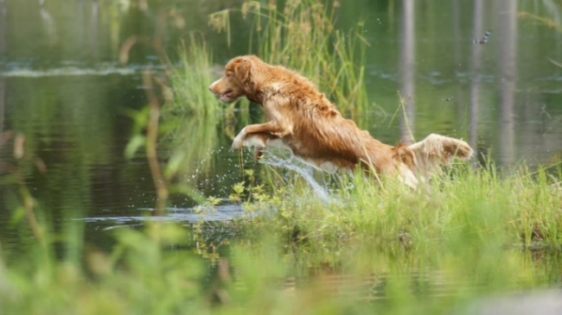
Junior Test Requirements
Dogs shall be tested on four single marks:
Two marks on land
Two marks on water
Test distances shall be established by the judges in keeping with realistic but relatively simple hunting situations
Length of retrieves cannot exceed 73.1 meters or 80 yards
Notes:
“Test distances shall be established by the judges in keeping with realistic but relatively simple hunting situations”

Slide 8
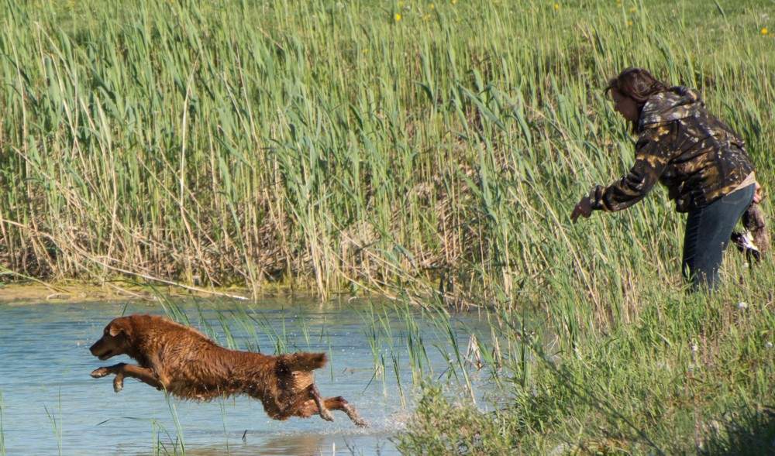
Junior Test Design Considerations
Diversionary shots, or shots in attempt to divert the attention of the dog, may NOT be used at the Junior level
Judges may use either hidden or visible gun stations
Visible gun stations may be used to a greater extent than would be appropriate in Senior or Master, but should still take into account the simulation of a hunting situation
Notes:
“In Junior hunt tests, visible gun stations may be used to a greater extent than would be appropriate in Senior or Master, but should still take into account the simulation of a hunting situation”
Some discussion could take place here with respect to use of visible gun stations at Junior, Senior and Master tests.

Slide 9
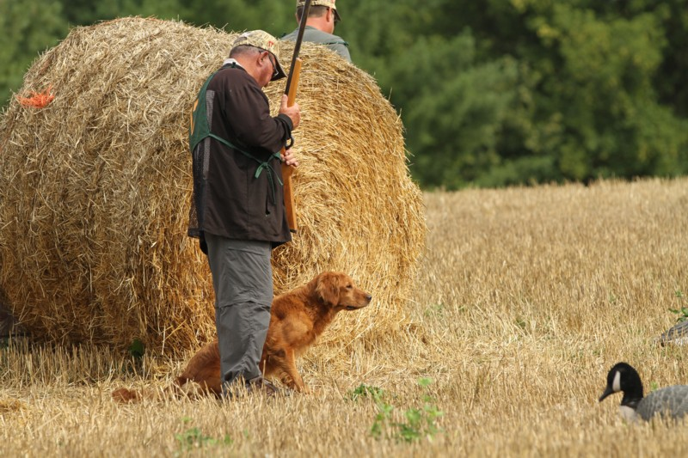
Junior Test Design Considerations Cont’d
Judges MAY require the handler in a Junior test to carry an empty shotgun or replica but can do so only once
The handler in Junior is NOT required to shoulder the shotgun
Judges should remember that one of the purposes of the Junior test is to encourage participants to continue on in the hunt test program

Slide 10
Evaluating the Junior Dog: General
A retriever’s prime purpose is to get bird to hand as quickly as possible in a pleasing and obedient manner using both natural and trained abilities
Judges must numerically evaluate, each out of 10, the following defined set of abilities against a standard as described in the CKC Rules and Regulations
Marking
Style
Perseverance
Training
These abilities will be scored against a standard as described in CKC Rules and Regulations, NOT in relation to other dogs
Scores must be shown to handlers upon request
Notes:
These abilities (Marking, Style, Perseverance, trainability) will NOT be defined in relation to the performance of the other dogs but instead against the standard as set out in the CKC hunt test rules and regulations.
Judges should compare their scores early in the test and throughout the test to see if they are relatively consistent in their numbers.

Slide 11
Evaluating the Junior Dog: General Cont’d
To qualify, an average score of 7 for the whole test (all series) must be achieved and must NOT include a score below 5 in any one ability (Marking, Style, Perseverance, Training)
When a dog is graded “0” by two judges on the same ability, it shall not be called back
A zero score is different from a non-score
A “0” indicates that the dog had an opportunity to exhibit an ability but failed to do so
A “non-score” indicates that an opportunity for the dog to exhibit an ability did not present itself
Notes:
To qualify, an overall test average of 7 must be achieved and must not include an average score below 5 in any one ability. Example: a score of 9 in some abilities could fail to qualify if the average score in one ability is below 5.
Possible scoring methods:
Determine whether the dog should qualify in that ability category, which might mean an ability score of 5. Knowing the dog must have an overall average of 7, the judge considers whether other abilities deserve a 7 or higher. With a five or less (but not with a zero by both judges), the dog would have to score higher in that ability and other abilities to acquire the 7 overall average.
A judge might want to compare the scores to grades received in school. For example, a 5, 6 or 7 might be comparable to a passing grade of C, an 8 would be a B, etc.
Another method could begin with a perfect score of 10 and progress downward.
Judges should take time to review and check their scores with each other before their scores become final.

Slide 12
Evaluating the Junior Dog: General Cont’d
The dog MUST retrieve to hand or a grade of “0” in trainability is merited
The dog may NOT be sent to retrieve until released to do so by the judges
Junior dogs may excel in marking and yet be scored lower, or not qualify for deficiencies in or lack of the other required abilities
For instance, dropping the bird before delivering, or conversely freezing and being unwilling to give it up, could range from a slight lowering of the score for an isolated incidence, to a “0” in Trainability for a severe freeze or refusal to pick up after multiple commands (15.4.2 (d))

Slide 13
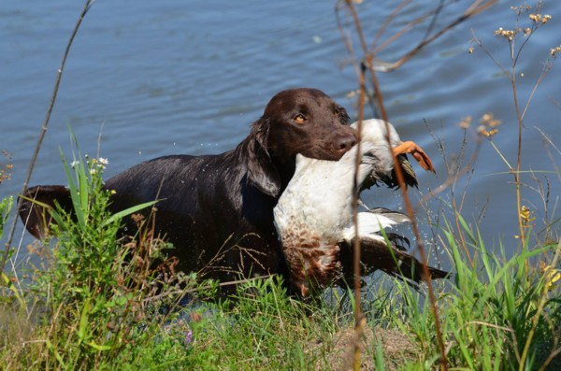
Evaluating the Junior Dog: General Cont’d
Trainability, as evidenced in steadiness, control, response and delivery, must be assessed to a lesser degree than it is at Senior
Any of the Serious Dog Faults described in section 16.3.1 of the CKC Rules and Regulations can be cause to award the dog a “0” in the relevant scoring category
Repeated incidences of moderate and/or minor dog faults in 16.4 and 16.5 can also accumulate to be more serious in nature to the point of being non-qualifying

Slide 14
Evaluating the Junior Dog: Recasts
Dogs may be sent to retrieve (recast) more than once
A ‘recast’ occurs when a dog makes a start towards a marked fall, but stops within a short distance of the line (approx. 5 yds/4.5m), returns or is recalled and sent to retrieve again
Recasts are often the result of a dog’s confusion as to whether it was sent to retrieve the firs time
Judges must take a second cast into consideration in evaluating marking and perseverance and will normally call for a lower grade
It is NOT considered a recast when the dog goes to the area of the fall, fails to find the bird or blinks (ignores) a bird it has found and returns or is recalled to the handler
This must be regarded as a lack of perseverance and can merit grading the dog “0” in marking or perseverance unless the judges perceive valid mitigating circumstances
Notes:
A discussion should take place at this point by asking the question, “How do you distinguish between a refusal and confusion?”
Factors to consider are:
Did the dog hear the command?
Was the command too loud so as to startle the dog?
Could the conditions that the dog is expected to enter be considered to test their perseverance such as cold or murky water (possibly leading to refusal)?
“This must be regarded as a lack of perseverance and can merit grading the dog “0” in marking or perseverance unless the judges perceive valid mitigating circumstances.”
Some discussion and explanation can take place around “marking or perseverance” under these circumstances.

Slide 15
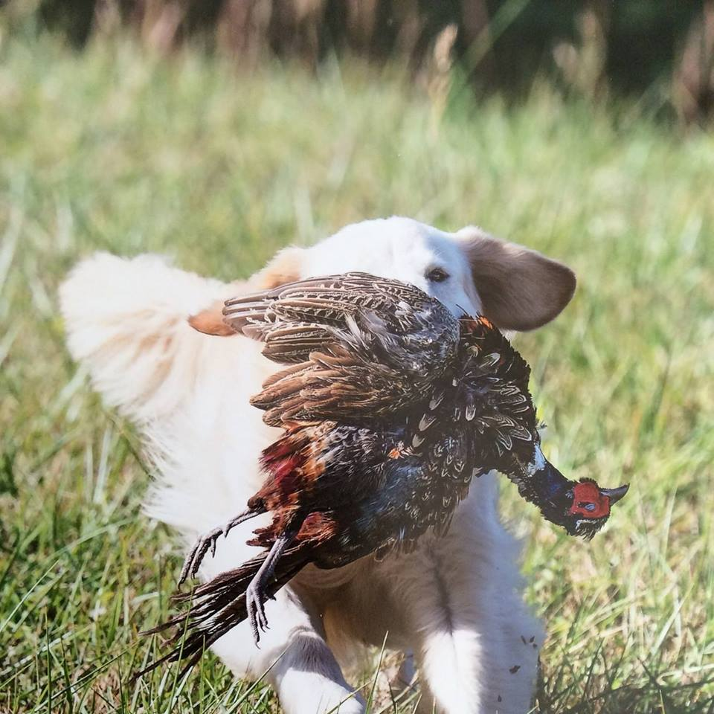
Evaluating the Junior Dog: Handling
Handling on more than one mark in Junior requires elimination (16.3.1.(u) as per 9.1.4) as the dog must show clear evidence to the judges of an ability to mark birds independently of the handler
If handling is required, it must be accomplished crisply and cleanly

Slide 16
Evaluating the Junior Dog: Steadiness
Dogs need not be completely steady but should demonstrate a reasonable degree of steadiness and general obedience in relation to trainability
They may be brought to line on leash however, they should also walk tractably at heel and must be under control
Dogs on line may be restrained gently with a slipcord or help gently by a collar until sent to retrieve
If a collar is used as restraint on line, it must be removed before the dog is sent to retrieve and it may not have a leash or tab attached to it
Prong or pinch collars are prohibited
A controlled break in Junior (if handler doesn’t use a restraint) is considered a minor dog fault and should be scored as such
Notes:
“Dogs need to be completely steady but should demonstrate a reasonable degree of steadiness and general obedience in relation to trainability.”
This means they are not expected to stay on the line without restraint as a Senior or Master dog would be expected to do, but ideally, they should sit quietly on the line while marks are going down as opposed to pulling and bucking and should come to heel and sit promptly when told to.

Slide 17
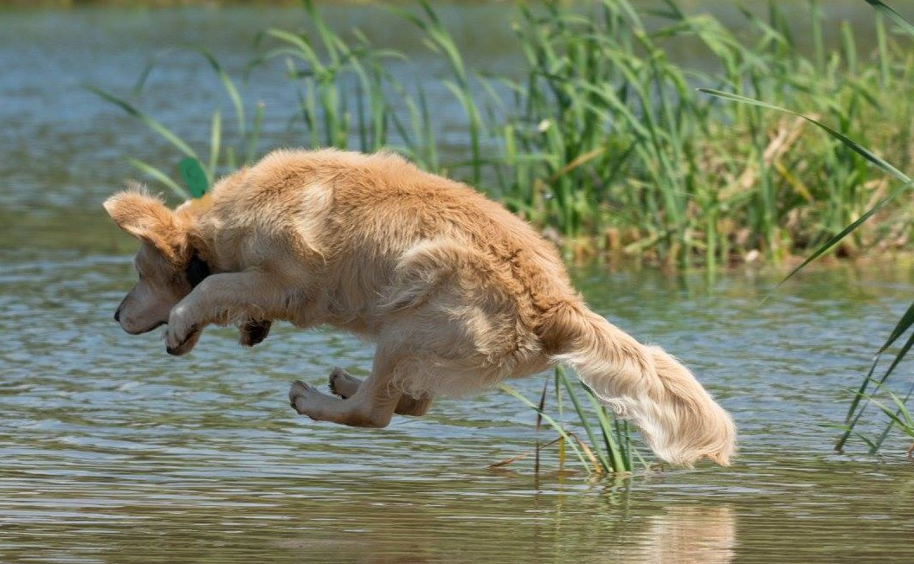
Evaluating the Junior Dog: Encouragement
A dog in a Junior test may be encouraged to hunt however, excessive noise in encouraging the dog suggests a lack of hunting desire
As such, a low score in perseverance is required for a dog needing this type of encouragement to continue searching for the bird

Slide 18
Evaluating the Junior Dog: Hard Mouth
Hard mouth is one of the most undesirable traits in a retriever
A dog can carry the stigma for life and therefore hard mouth requires incontrovertible proof
Torn skin or flesh alone is not usually sufficient evidence for proof as it may be caused in a variety of ways, such as by sharp sticks or stones, etc. in the cover as well as by the dog’s fast, positive pick-up
Crushed bone structure can usually be accepted as trustworthy and sufficient evidence of hard mouth

Slide 19
Evaluating the Junior Dog: Hard Mouth Cont’d
Other undesirable traits are frequently confused with hard mouth such as freezing with bird in mouth
A hard mouthed dog may still have a gentle delivery and certainly a reluctant or sticky delivery does NOT imply hard mouth
Rolling or mouthing the bird during a retrieve may be erroneously associated with hard mouth as well even when the bird is not damaged
Such mouthing may not necessarily call for a lowering of a trainability score
The judge should remember a dog either does or does not have a hard mouth, and if it does, cannot receive a qualifying score

Slide 20
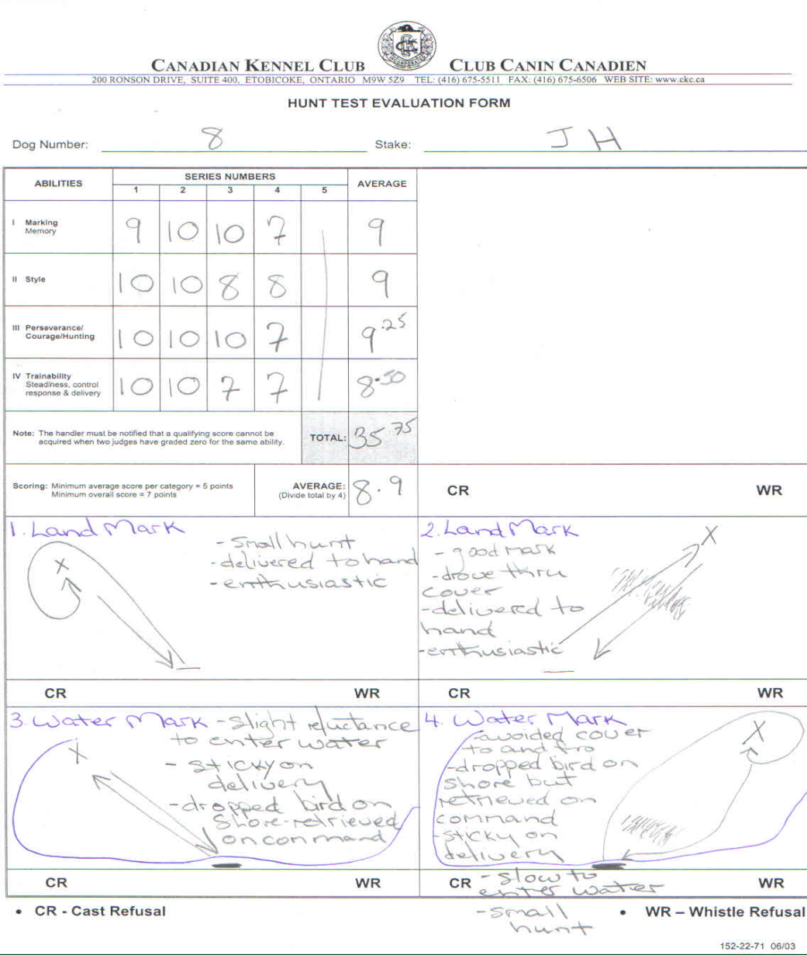
Evaluating the Junior Dog: Sample Score Sheet
Notes:
Master test usually consists of the following 5 series: - Land marks, Water marks, Land blind, Water blind, Quarter and flush
To qualify, an average score of 7 for the whole test (all series) must be achieved and must NOT include an average score below 5 in any one ability (Marking, Style, Perseverance, Trainability)
Possible Scoring Methods:
Determine whether dog should qualify in that ability category, which might mean an ability score of 5. Knowing the dog must have an overall average of 7, the judge considers whether other abilities deserve a 7 or higher. With a five or less (but not with a zero by both judges), the dog would have to score higher in that ability and other abilities to acquire the 7 overall average.
A judge might want to compare the scores to grades received in school. For example, a 5, 6 or 7 might be comparable to a passing grade of C, an 8 would be a B, etc.
Another method could begin with a perfect score of 10 and progress downward.
Judges should take time to review and check their scores with each other before their scores become final.
The score sheet sample above represents a SOLID PASS.

Slide 21
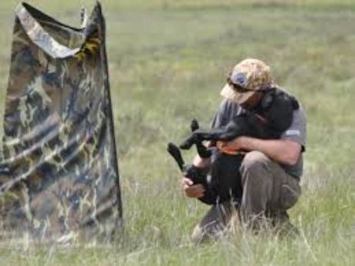
Perhaps Above All
Hunt tests should be an enjoyable sport in which handlers and their dogs get to work as a team and have fun
Thank you!
Notes:
When judging and faced with a difficult decision, a question that a judge may wish to ask her or himself is, “would I want to hunt with this dog?”

